Slide 1
Jim Ingersoll

Slide 2
Beginner – Survival mode
Estate Builder – Stability zone. Building assets and lasting cash flow
Ender – FREEDOM – Assets (F&C, Leveraged), Notes, Lending = Diversity Freedom (Reduce risk)

Slide 3
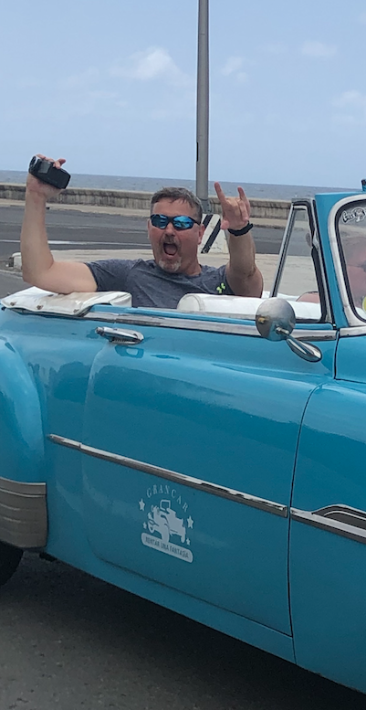
Ray Ferguson…
Everything needed to be an elite deal maker is in this room right now….

Slide 4
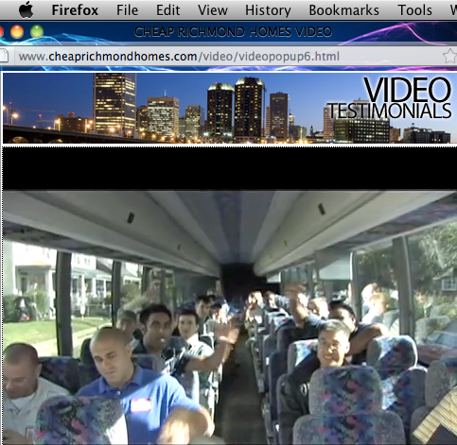
Jim Ingersoll
Investor, Author, Podcaster, Host Deal Maker 2020 Live
www.InvestingNowNetwork.com Real Estate Success Podcast
Facebook group: Real Estate Investor Success jimingersoll@Verizon.net

Slide 5
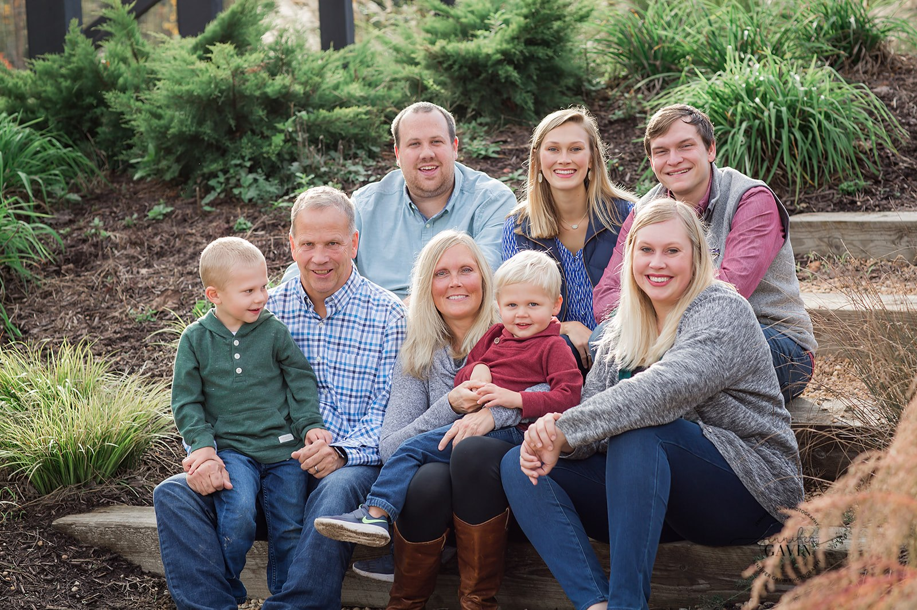
Jim Ingersoll – Investor, Author, Podcaster We all invest!
jimingersoll@Verizon.net

Slide 6
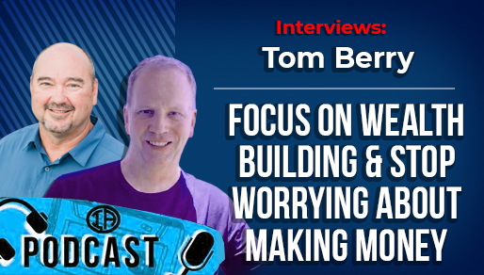
“Focus on building wealth & stop worrying about money
as soon as you can…” Tom Berry
Notes:
Your Lead Generation OR Leverage your networks

Slide 7
10 Traits of successful deal makers
1. Invest in themselves & their teams to have the best skills
2. Invest in strong relationships with successful people, mentors and build out strong networks and relationships!
3. Clear goals, written down, and constantly measure their results throughout the year

Slide 8
10 Traits of successful deal makers
Know their “why”
Give/serve/mission
Emotional control

Slide 9
Traits of successful deal makers
7. Focus & great time management 8. Gratitude everyday
9. Self-worth and positive mindset
10. Highest possible Character and Integrity

Slide 10
Traits of successful deal makers
11. Read (or listen) Books, Podcasts, YouTube University….

Slide 11
But how do we make GREAT deals?
Notes:
Your Lead Generation OR Leverage your networks

Slide 12
Deal Flow (or access)
Notes:
Your Lead Generation OR Leverage your networks

Slide 13
Operate w/o their own cash!
Notes:
Your Lead Generation OR Leverage your networks

Slide 14
Leverage
OPM, OPI, OPD, OPT…
Notes:
Money – Knowledge – experience –
Make today the day you overcome!

Slide 15
Funding, Structuring & Control - BIG tool box & Access
Notes:
Private money – relationships. Brrr, seller financing, sub 2 deals, options

Slide 16
Long-term thinking
Notes:
Wholesalers – days/weeks. Fiippers – Months. Private Lenders – Months. JV Financiers – A few years. Landlords/Note investors – Multiple Years. Legacy builders - Decades

Slide 17
Tax Strategies on steroids
Notes:
1031 Exchanges – Self Directed IRAs – Opportunity Zones

Slide 18
Decisive Action
Notes:
Quick decisions with limited info/due diligence of the critical few items

Slide 19
Negotiator
Notes:
Listening is critical. Mirroring. Tactical empathy. Making the discussion about the other pereson

Slide 20
Network Builder
“If your net worth is not increasing fast enough, you need to challenge your network”
Notes:
Money – Knowledge – experience –
Make today the day you overcome!

Slide 21
Make decisions with numbers, not emotions
“Is
Notes:
Money – Knowledge – experience –
Make today the day you overcome!

Slide 22
Privacy
“Is there a circumstance you can think of where you would want
The general public to know the houses you own?”
Notes:
Money – Knowledge – experience –
Make today the day you overcome!

Slide 23
Implementation (Massive Action)
Notes:
Money – Knowledge – experience –
Make today the day you overcome!

Slide 24
Protector at all costs
Notes:
When things go wrong, don’t bury head in the sand. Man up and make it right

Slide 25
Legacy Builders
Notes:
When things go wrong, don’t bury head in the sand. Man up and make it right

Slide 26
Lifetime learner
Notes:
Money – Knowledge – experience –
Make today the day you overcome!

Slide 27
Problem solver, Mission focused
Notes:
Money – Knowledge – experience –
Make today the day you overcome!

Slide 28
Traits of successful deal makers
1. Invest in themselves & their teams 2. Invest in strong relationships
3. Clear goals, written down
Know their “why”
5. Give/serve/mission
6. Emotional control

Slide 29
10 Traits of successful deal makers
7. Focus & great time management
8. Gratitude everyday
9. Self-worth and positive mindset
Highest possible Character and Integrity
Read, listen to books, podcasts, YouTube

Slide 30
Deals, Funding, Knowledge, Network?
Notes:
Money – Knowledge – experience –
Make today the day you overcome!

Slide 31
Notes:
When should I start?
Am I too young or too old?
Don’t have enough money?

Slide 32
Speakers = content
Panels = Discussions
Focus on the People!
Network = Net worth

Slide 33
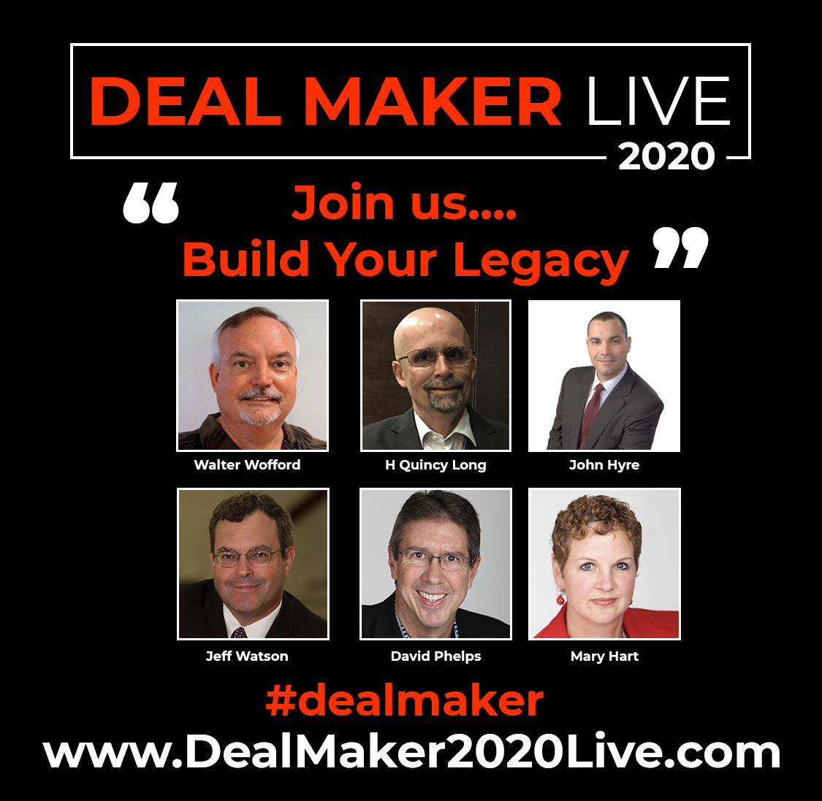
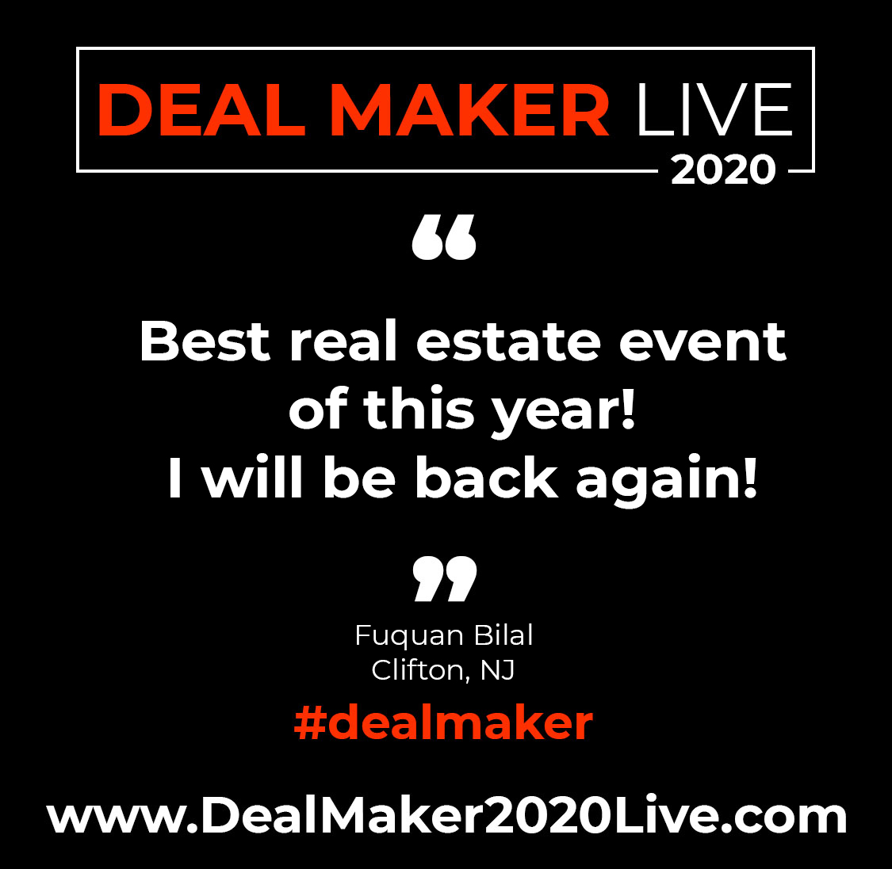
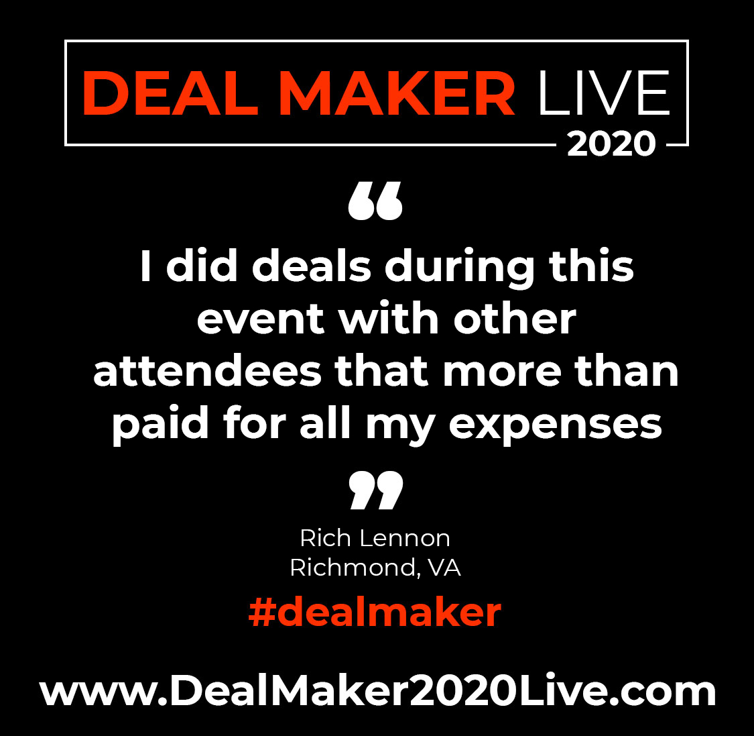
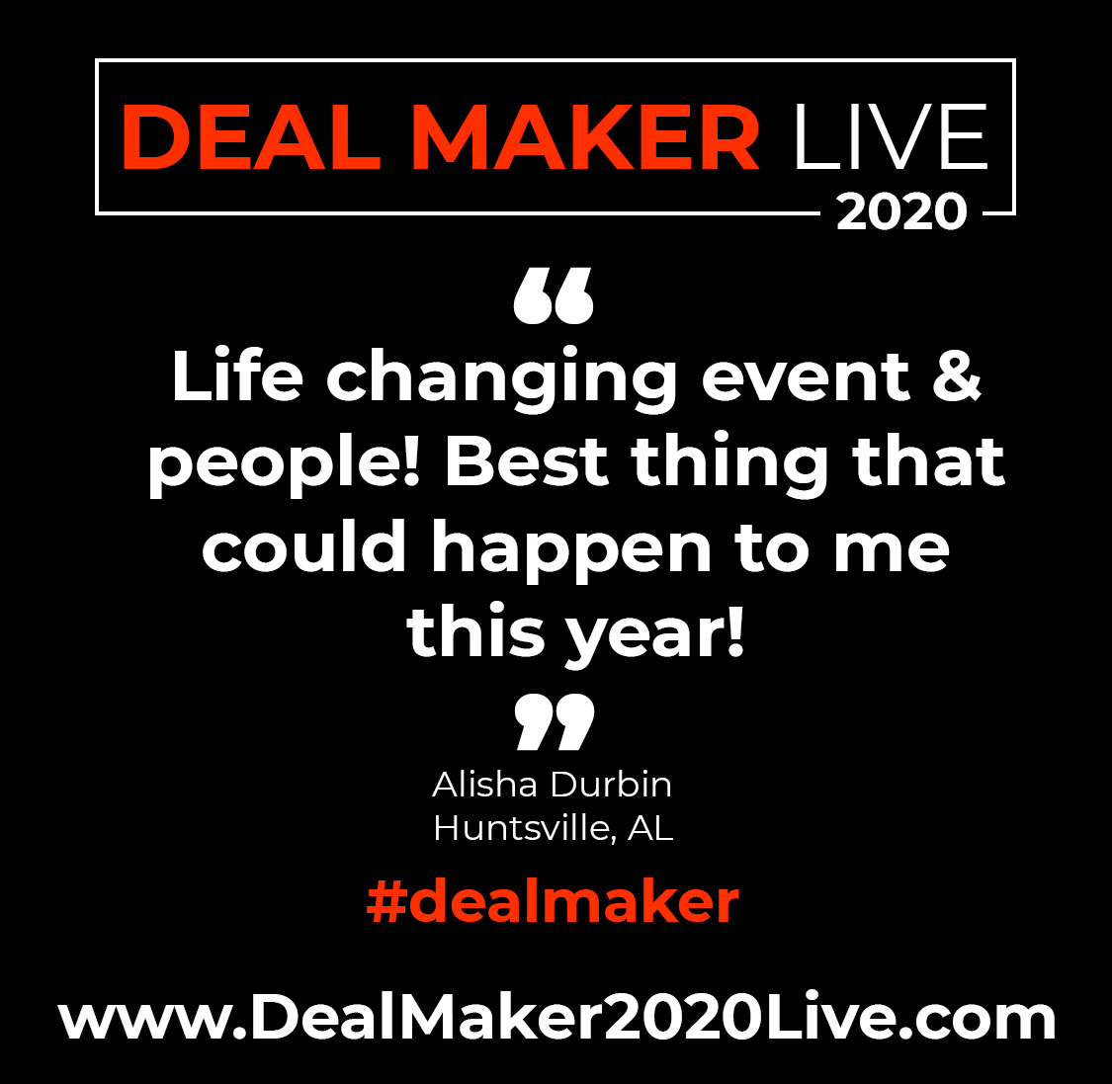
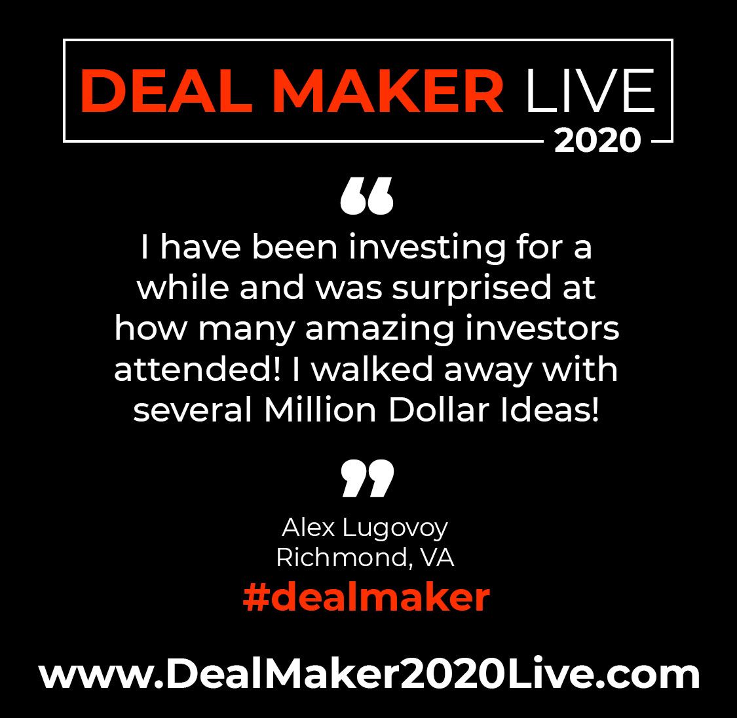
Notes:
Money – Knowledge – experience –
Make today the day you overcome!

Slide 34
Notes:
Money – Knowledge – experience –
Make today the day you overcome!

